Slide 1

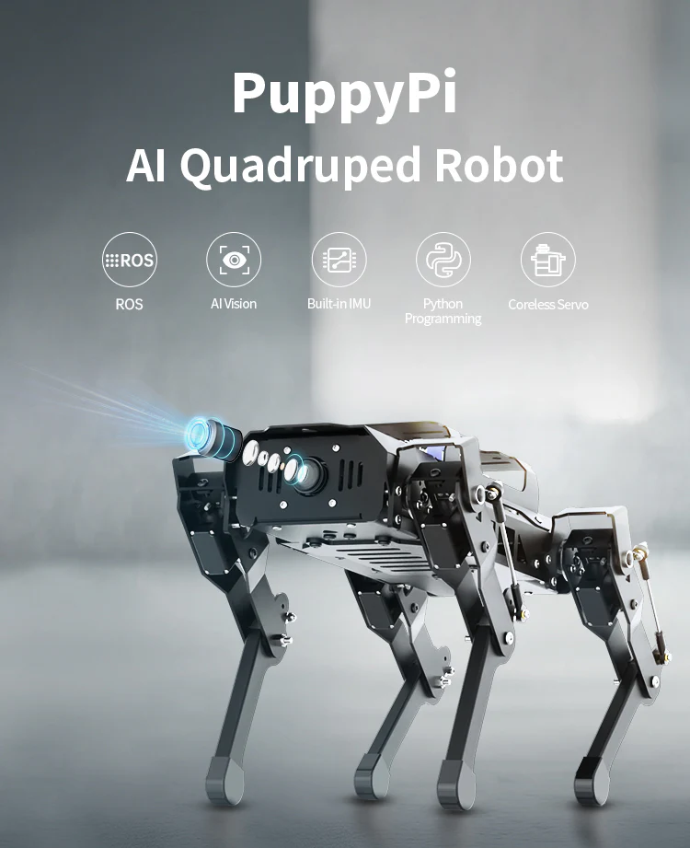

Cloud Robotics Capstone Project
Olivia Monteiro, Alicia Reed, Danny Steuer,
Archer Taylor, Eli Weber

Slide 2
Overview
PuppyPi is an AI vision quadruped robot that has capabilities including autonomous mapping, navigation and path planning, the capability to play many different games, gait changes and more
Limited previous work in the field of quadruped research with K-12 students
Our project will provide a client-server architecture to develop educational systems to support STEM interest in K-12 students

Slide 3
Use Cases
The primary purpose is to support STEM interest in K-12 students
Developing interesting, child-friendly educational resources
Used in the classroom, in demonstrations, etc.
Primary user demographic includes children, K-12 educators, and enrichment programs

Slide 4
Core Features
We’ve been asked to create an application with these core features:
Support for quadruped control and sending commands to the PuppyPi
Support for gathering sensor data from the PuppyPi platform
Support for interpreting basic sensor data sent from the PuppyPi client on a cloud server
Sending back other commands from the cloud server to the PuppyPi
In essence, a cloud-based data analysis & control platform for PuppyPi.
Notes:
Dr. Crawford has asked us to create a cloud-based application with the following core features: First, there should be some support for controlling the quadruped and sending commands to the PuppyPi. Secondly, we should be able to gather some sensor data from the PuppyPi. This can include data from the PuppyPi's visual sensors or from some other environment sensors attached to the platform. Third, we should be able to interpret that sensor data on our cloud platform. Simply put, we need to process and analyze our data on the server. Lastly, Dr. Crawford has asked us to send back non-movement commands from the cloud server. This could be things such as requesting a real-time sensor snapshot, shutting down the platform, and more. In essence, we are creating a cloud-based data analysis & control platform.

Slide 5
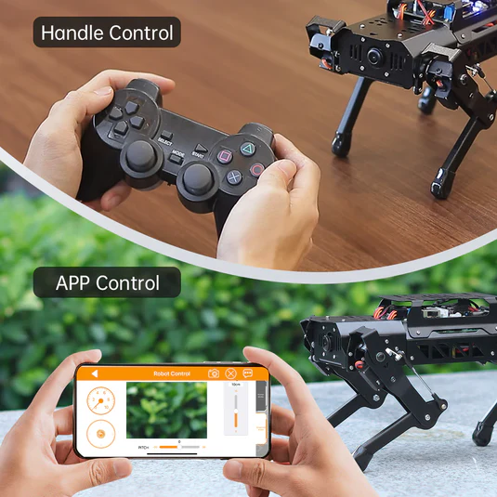
Technical Details
We require knowledge of the following:
Raspberry Pi 4B/5 and ROS (Robot Operating System)
OpenCV, a Python library used by PuppyPi for image processing
Integration with WonderPi & API (an app for controlling the robot movement)
HuggingFace - a computer vision Python library
Notes:
In regards to the technical details, we require knowledge of the following: Raspberry Pi and ROS, which stands for Robot Operating System, the OS that the PuppyPi quadruped runs on. OpenCV, which is a python library that PuppyPi uses for processing images from its visual sensors. The WonderPi App and its API, as this might provide us with an easy way of sending movement commands to the PuppyPi. And lastly, Dr. Crawford has asked us to take a look at using HuggingFace for this project. This is a computer vision Python Library.

Slide 6
Development Environment
A major part of this project is creating a cloud application. As a result, a major development environment will be Amazon Web Services.
AWS’s products will allow for design, integration, and testing of the application all in one place.
Furthermore, we anticipate that we’ll need to do some actual hardware interfacing with the Raspberry Pi and ROS (Robot Operating System).

Slide 7
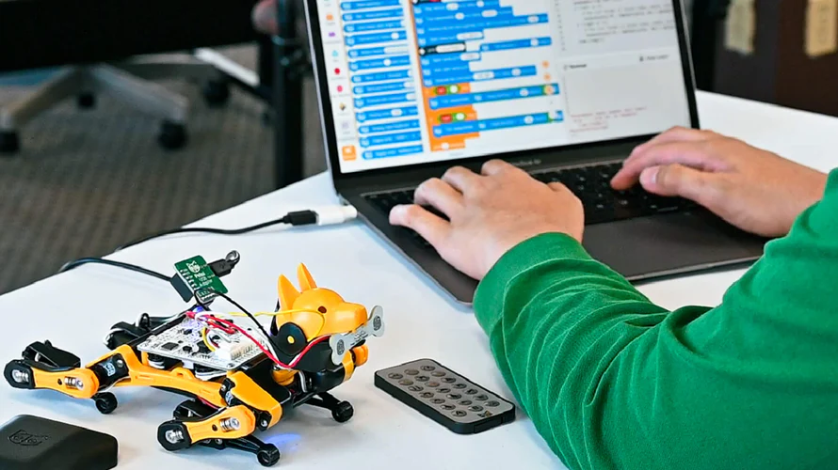
Competitors
Scratch / Scratch Tello
Tynker / Tynker Tello
Few to no other competitors in the education space
Block-based programming for kids to send commands and receive data from drones and LEGO robotics kits.
Notes:
Though there aren’t many other competitors focused on education, two similar ones are scratch and tynker. Scratch focuses on block coding which simplifies lines of code into separate blocks that have slight alterationsa allowing for children to understand key concepts of programming. Tynker uses gamified lessons to teach coding lessons and has some hardware compatibility.
PuppyPi will differ in that there will be a physical apparatus for hands on learning with more advanced systems than its competitors. It has a larger focus on robotics, sensor data, and AI bridging the gap between coding and real world applications.

Slide 8
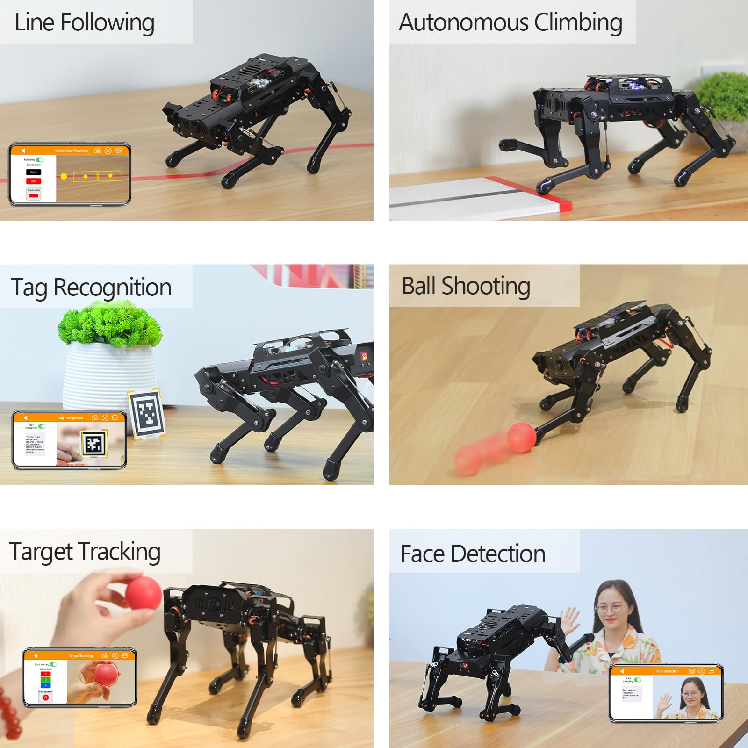
Challenges
The primary challenges of this project will include:
Learning ROS (Robot Operating System)
Learning how to communicate with PuppyPi (Wi-Fi? Special sensors? etc..)
Applying networking concepts (e.g. websockets)
Processing data from the vision of the PuppyPi
Depending on the requirements, this could be a very complex task
Notes:
Though there aren’t many other competitors focused on education, two similar ones are scratch and tynker. Scratch focuses on block coding which simplifies lines of code into separate blocks that have slight alterationsa allowing for children to understand key concepts of programming. Tynker uses gamified lessons to teach coding lessons and has some hardware compatibility.
PuppyPi will differ in that there will be a physical apparatus for hands on learning with more advanced systems than its competitors. It has a larger focus on robotics, sensor data, and AI bridging the gap between coding and real world applications.

Slide 9
Thank you!
Notes:
Though there aren’t many other competitors focused on education, two similar ones are scratch and tynker. Scratch focuses on block coding which simplifies lines of code into separate blocks that have slight alterationsa allowing for children to understand key concepts of programming. Tynker uses gamified lessons to teach coding lessons and has some hardware compatibility.
PuppyPi will differ in that there will be a physical apparatus for hands on learning with more advanced systems than its competitors. It has a larger focus on robotics, sensor data, and AI bridging the gap between coding and real world applications.

